Slide 1


VIT-AP
UNIVERSITY
ANTI SLEEP ALARM FOR DRIVERS

Slide 2


CONTENTS
INTRODUCTION
PROBLEM STATEMENT
WHY THIS?
COMPONENTS
BUDGET
PLAN OF ACTION
TIMELINE

Slide 3

INTRODUCTION
Driving when you're really tired is super dangerous and causes a lot of accidents and even deaths. The usual ways we try to avoid it aren't always enough. So, this project is about making a special alarm for cars that can tell if the driver is getting too tired and wake them up if they are, so they can stay safe on the road. It'll use sensors and smart tech to watch how the driver is doing and give a warning if they need to take a break, making driving safer for everyone.

Slide 4




TITLE
Developing a Driver Alert System to Prevent Accidents from Drowsy Driving
PROBLEM STATEMENT
Driving while tired causes accidents. Current
methods to stay awake, like taking breaks or drinking coffee, don't always work. This project aims to create an alarm for cars that can detect if the driver is getting too tired and wake them up, making driving safer.

Slide 5

WHY THIS?
The main reason for this project aims to enhance road safety by addressing the risks associated with driver fatigue.
By this project we may prevent those accidents.

Slide 6
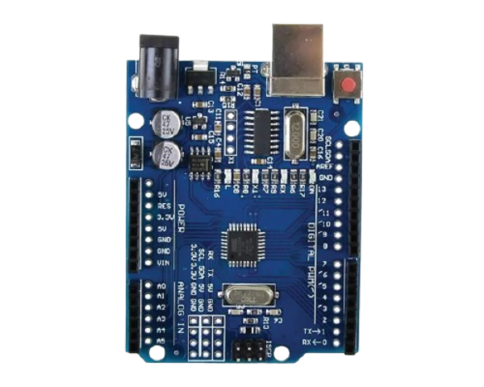
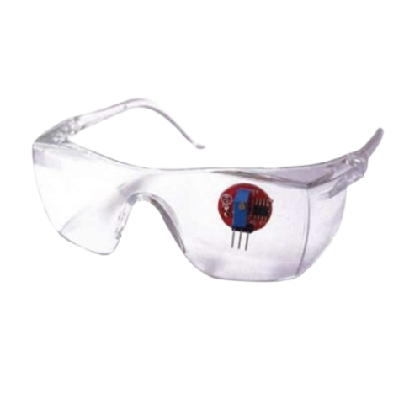
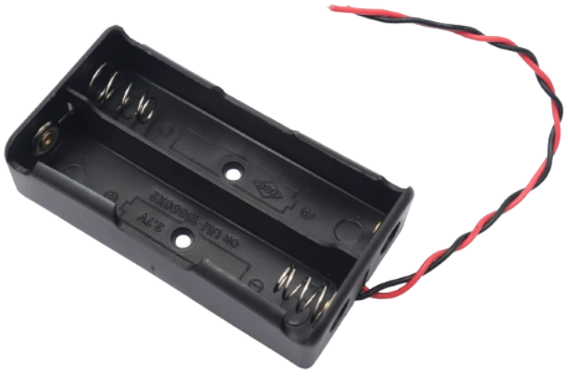
COMPONENTS
ARDUINO UNO SMD
IR GOGGLES
BATTERY HOLDER

Slide 7

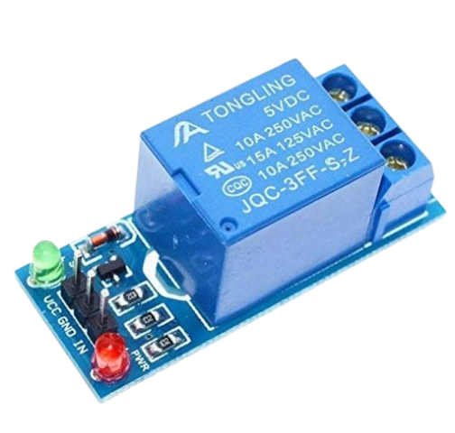
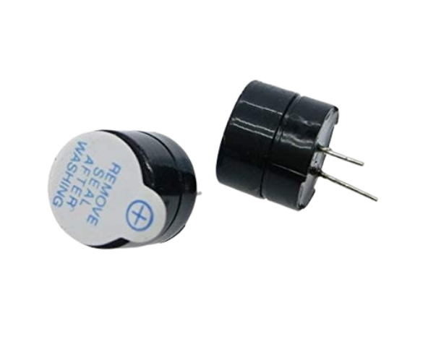
LITHIUM BATTERIES
RELAY MODULE
MINI BUZZER

Slide 8
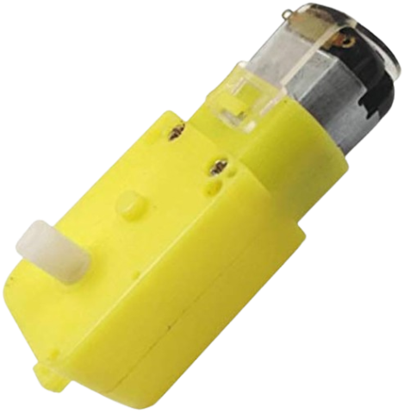


BO MOTOR
BO WHEEL
SUN BOARD

Slide 9


BUDGET
The project budget will be influenced by the quality and complexity of the components needed for the anti-sleep alarm system. For a basic system, the estimated cost may range from 4000 rupees to 8000 rupees. However, this estimate does not include any expenses associated with developing custom software or incorporating advanced features. The final budget will depend on factors such as the specific components choosen, their quality, and any additional functionalities required for the system.

Slide 10

PLAN OF ACTION
Research and Requirement Definition.
Component Selection.
Circuit Design and Software Development.
Prototyping and Testing.
Iterative Design and Finalization.
Assembly and Final Testing.
Documentation and Reporting.
Presentation and Demonstration.
Deployment or Further Development.
Project Review and Reflection.

Slide 11




P
TIMELINE
FEBRUARY
MARCH
APRIL
MAY
Title,problem statement,
components
Demonstration of working principle
Corrections given by guide
Final report

Slide 12

OUR TEAM
A.SADHANA
A.V.S.S. LIKHITHA
B.TANUSREE
21BCE9924
21BCE9931
21BCE9938
K.ANJI NAIK
P.DINESH
21BCE9744
21BCE9705

Slide 13


